Slide 1
Python for Data Science
MLDA@eee Workshop

Slide 2

MLDA@EEE
Our mission:
Provide an integrated platform for EEE/IEM students to learn and implement Machine Learning, Data Science & AI, as well as facilitate connections with the industry.
•>17 Workshops
•>1000 Trained ML practitioners
•>10 Academic Projects
•>30 Industry projects
•>5 competition
•>15 Industry Partners

Slide 3
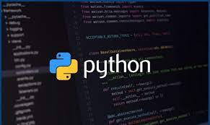
Why use Python?
Python is a programming language that is:
Easy to interpret
High level
Object Oriented

Slide 4
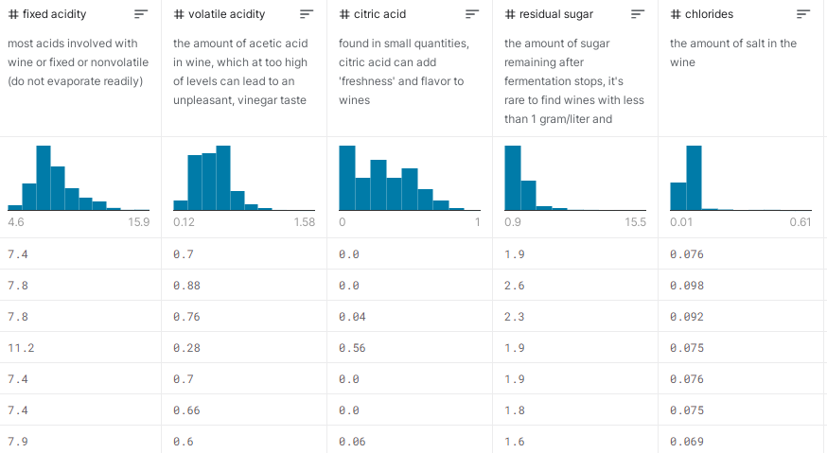
Python and Data Science
Data Science is the combination of programming, mathematics and statistics to extract meaningful insights from data.
According to SlashData, there are 8.2 million active Python users with “a whopping 69% of machine learning developers and data scientists now us[ing] Python (compared to 24% of them using R).” https://datavizcatalogue.com/

Slide 5

Data Visualization
It is the visual representation of data to gain new insights about information.
Transform raw data into visual objects
Good visualisation:
Simplify the complexity in data
Easily understandable information

Slide 6
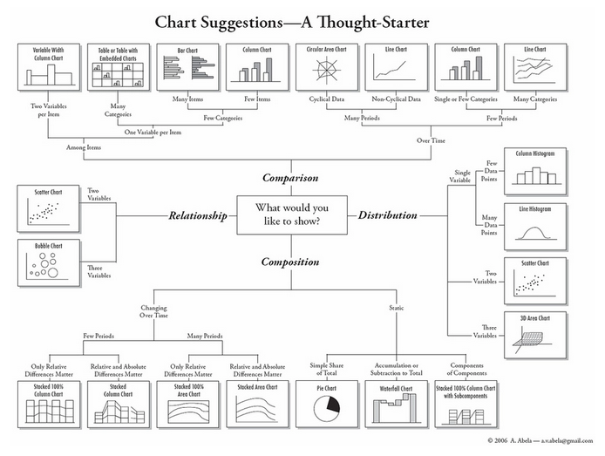
https://datavizcatalogue.com/

Slide 7
Constants
Constants are fixed values such as numbers, letters and strings.
Numeric constants are numbers.
String constants are denoted using single(‘) or double quotes(“).

Slide 8
Python Reserved Words
Python has a small set of words that have their own purpose called Reserved Words.
No object can have the same name as a Reserved word.
Reserved words are case sensitive. The upper case and smaller case shown in the words must be followed.
False def if raise None del import return True elif in try and else is while as except lambda with assert finally nonlocal yield break for not class from or continue global pass

Slide 9
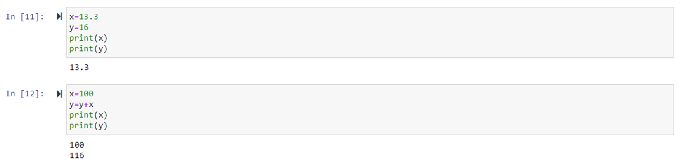
Variables
Variables have a place in the memory and are used to store data.
The content of a variable can be changed in the following code.

Slide 10
Operators
Arithmetic Operators | Operation | Example | Result
+ | Addition | a+b | 13
- | Subtraction | a-b | 5
* | Multiplication | a*b | 36
/ | Division | a/b | 2.5
% | Modulus gives remainder of division | a%b | 1
** | Exponential power calculator | a**b | 6561
// | Integer division performs division and only gives the integer value | a//b | 2
a=9, b=4
Comparison Operators | Meaning | Example | Result
< | Less than | 9<4 | False
> | Greater than | 9>4 | True
<= | Less than or equal to | 9<=4 | False
>= | Greater than or equal to | 9>=4 | True
== | Equal to | 9==4 | False
!= | Not equal to | 9!=4 | True

Slide 11
Operator Precedence
There is an order of precedence to the arithmetic operators.
The operation to be performed first will have highest precedence.
In the order of highest to lowest precedence:
Parantheses ()
Exponential power
Multiplication, Division and remainder
Addition and Subtraction
Left to Right
x = 1 +2 ** 3 /4 *5
print(x)
Output:
11

Slide 12
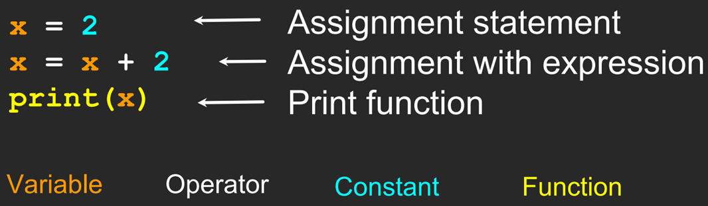
Know your code

Slide 13


Python knows the data
Variables and constants have a data type:
Constants are of integer data type
Variables that contain letters or words are of string data type.
Do you think Python is smart?
How about now?

Slide 14
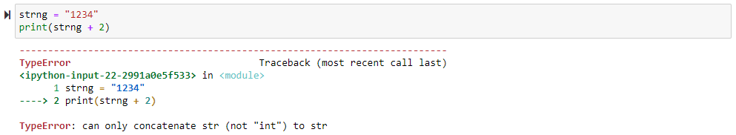
Data type manipulation
Numbers are mainly of 2 data types: Integers and Floating points
Integers are whole numbers.
Floating points have decimal in their values.
A string can be changed to an integer data type.

Slide 15
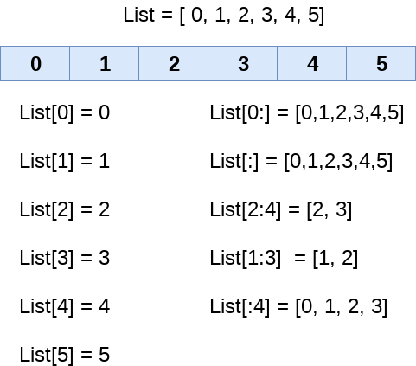
Lists
Lists are collections used to store multiple items in a single variable.

Slide 16
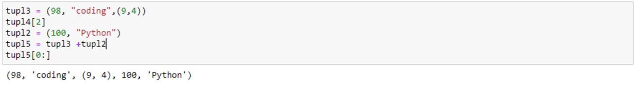
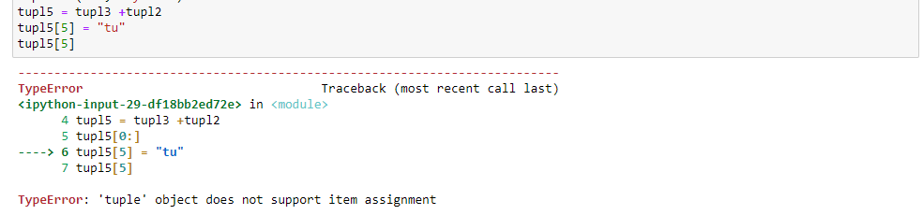
Tuples
A tuple is a collection that is unchangeable.
The data in tuple is unchangeable.

Slide 17
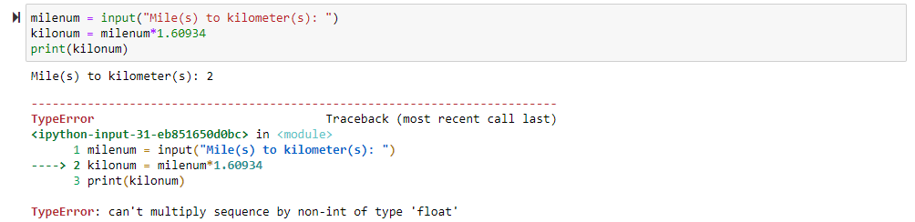
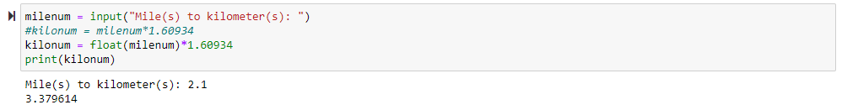
User Input
Python can pause and read data from the user.
The input() function is used for this purpose.

Slide 18
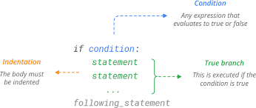
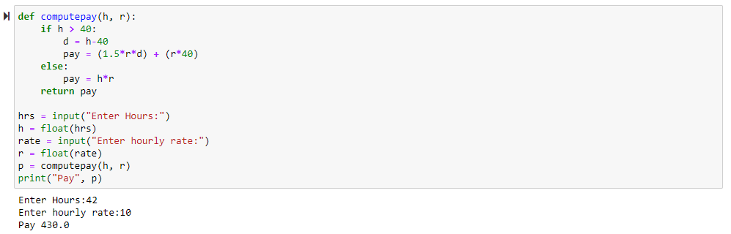
If condition
If, elif, else are used in making decisions in a code.

Slide 19
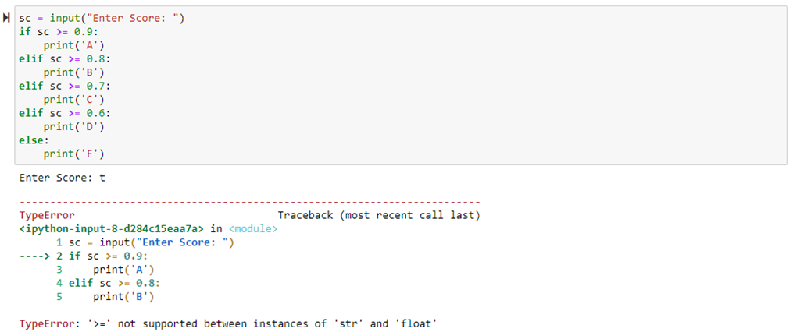
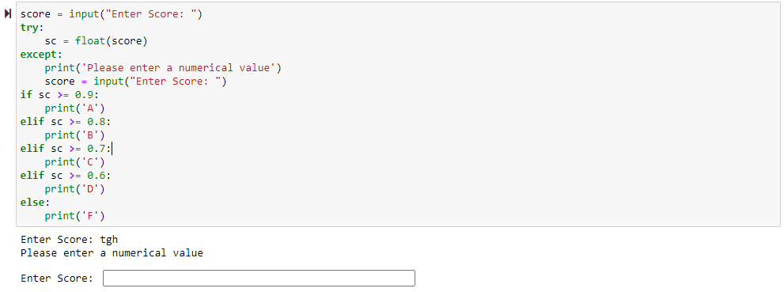
Multiple conditions

Slide 20
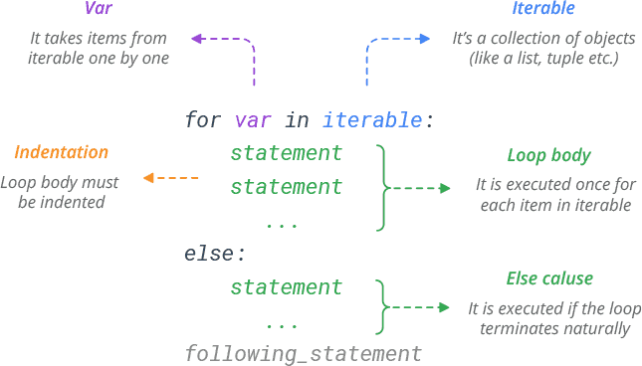
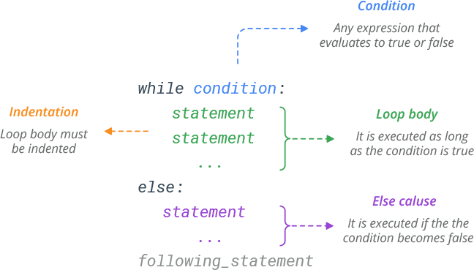
Loops(for, while)
Loops are used to repeat an action multiple times for a given set of data.
Iterate through an iterable object like list, tuple, array

Slide 21
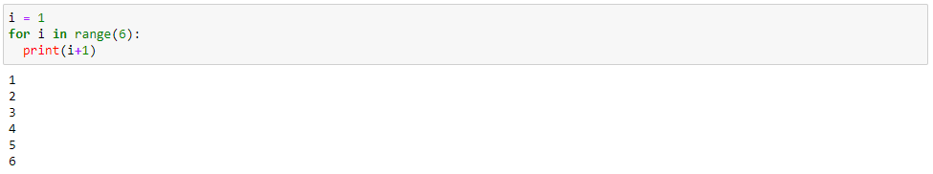
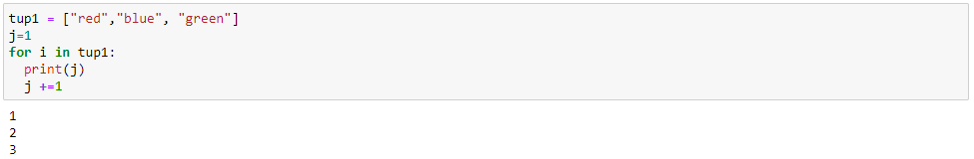
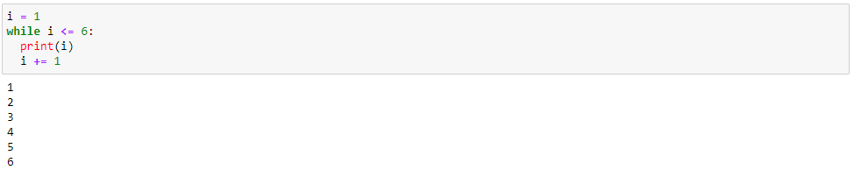
Loops examples

Slide 22

Let’s code!!

Slide 23
Python Libraries
Python has many libraries that makes it easier for coding in data science.
A library is a collection of modules with pre built code to help with common tasks.
Libraries you will be using:
NumPy
Pandas
MatplotLib
Seaborn

Slide 24

NumPy
NumPy is the core scientific computing package in Python.
It is used to perform mathematical operations on multidimensional arrays.
Assume that the arrays now have a million rows. Will the code be time efficient?
NumPy gives us the best of both worlds: element-by-element operations are the “default mode” when an ndarray is involved, but the element-by-element operation is speedily executed by pre-compiled C code.

Slide 25
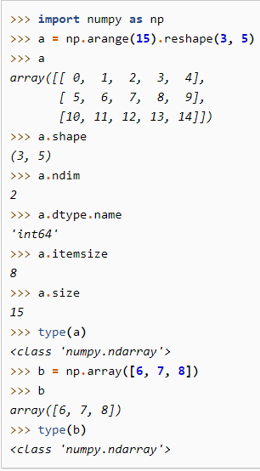
Example of a NumPy array
ndarray.shape
ndarray.ndim
ndarray.dtype
ndarray.itemsize
ndarray.size

Slide 26
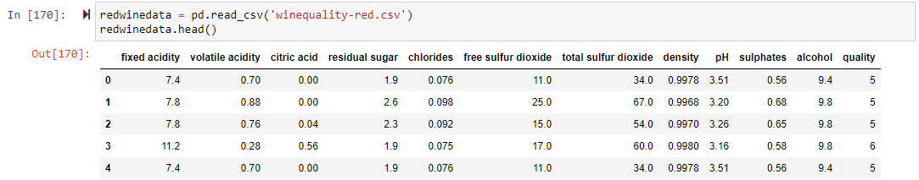
Pandas
It is used for easy manipulation of tabular data for data cleaning and data analysis.
It is an easy-to-use library.
Tabular data is declared as a panda dataframe.
https://pandas.pydata.org/docs/

Slide 27
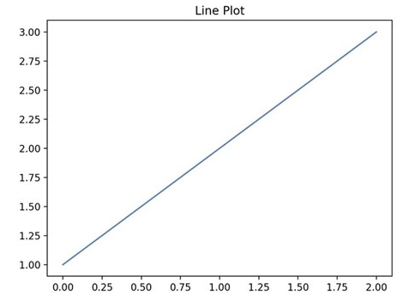
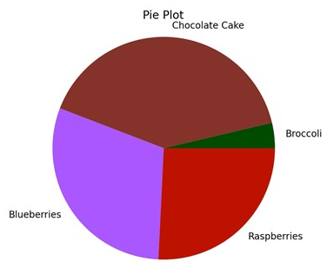
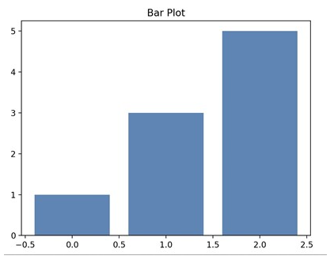
MatplotLib
MatPlotLib is a data visualisation and graphical tool library.
It is used to express the vast amount of data in an easily interpreted way.

Slide 28
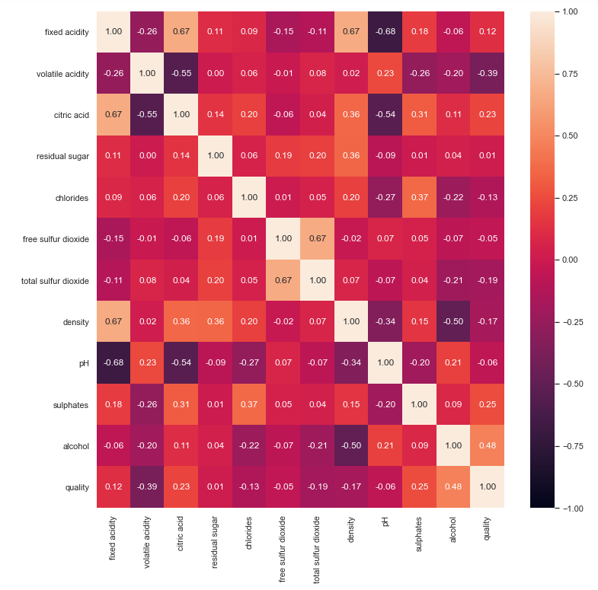
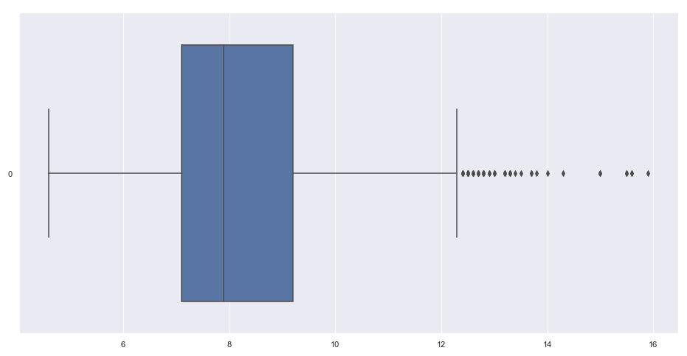
Seaborn
It is used for making statistical graphs in Python.
It provides a high-level interface for drawing attractive and informative statistical graphics.
Correlation matrix
Boxplot

Slide 29

Feedback Form
https://forms.gle/Xy2m5m7Qtgy9oZWG9
Thank You!

